Slide 1


Presented by: Tebogo Tseka
Date: 29 September 2023

Slide 2
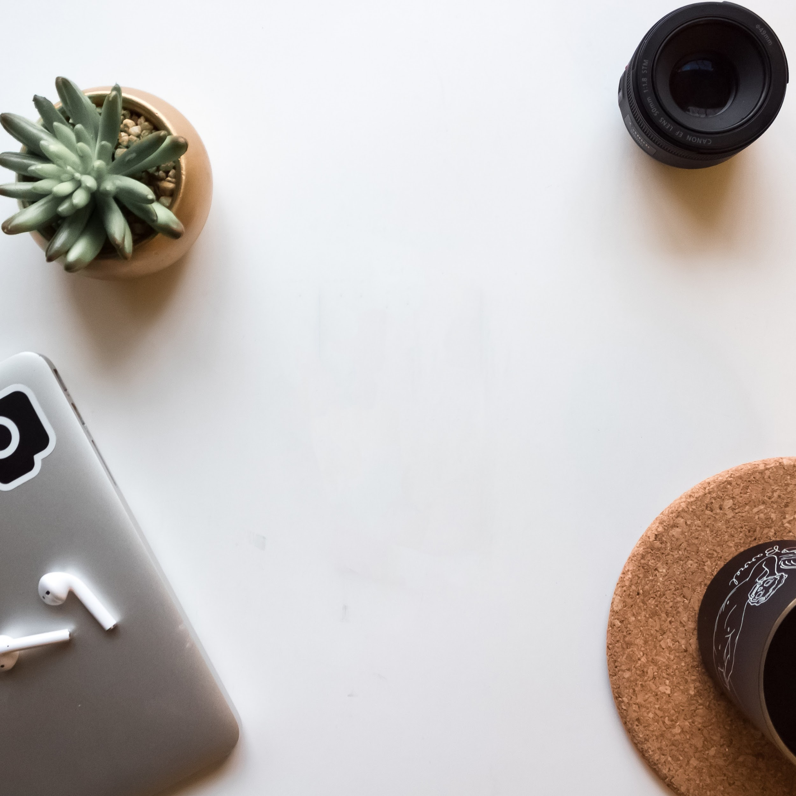
Agenda
Problem Statement
Solution
Other Options
Decisions
Conclusion

Slide 3

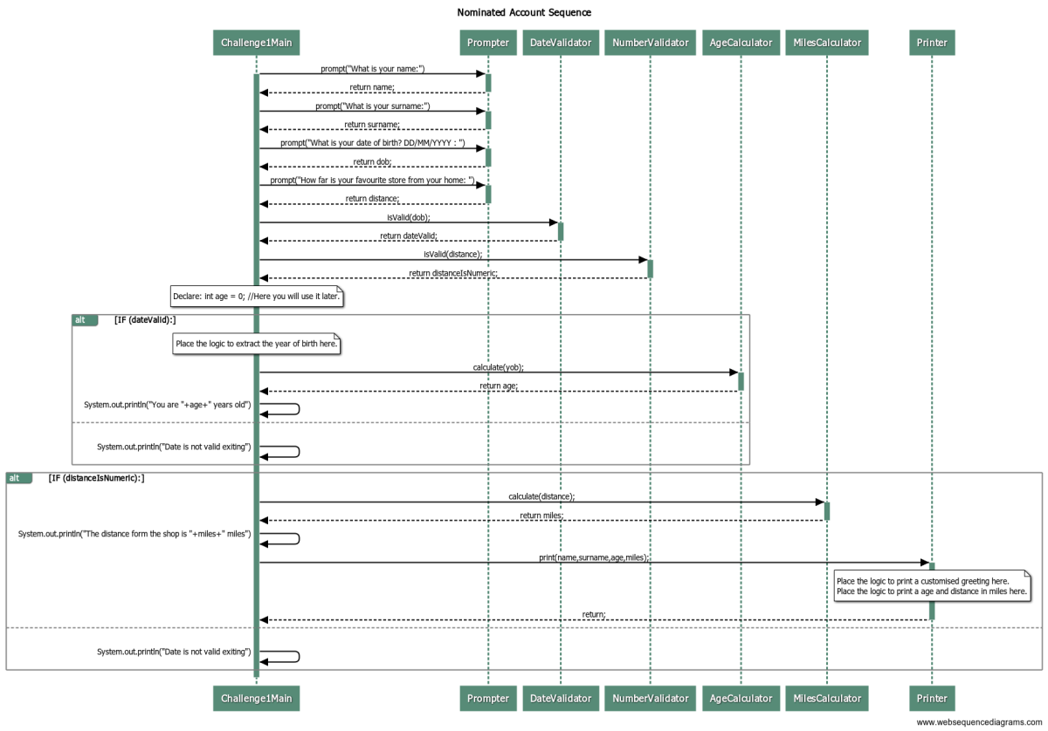
Problem statement
The task was to create an interactive Java program that collects user information, validates input, calculates age, and converts distance from kilometers to miles..
The program needed to handle name, surname, date of birth (in DD/MM/YYYY format), and distance from home to a store (in kilometers).

Slide 4
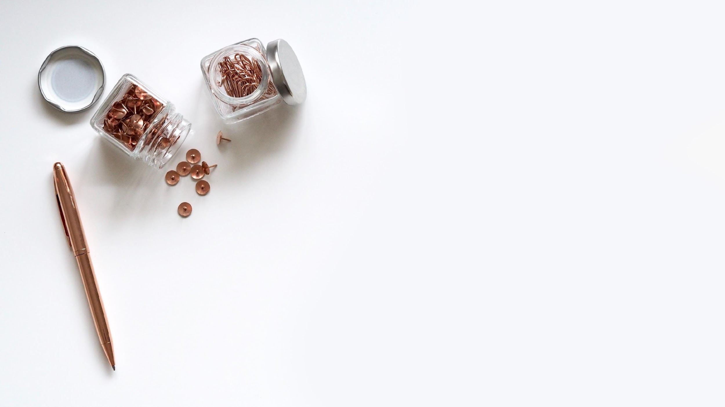
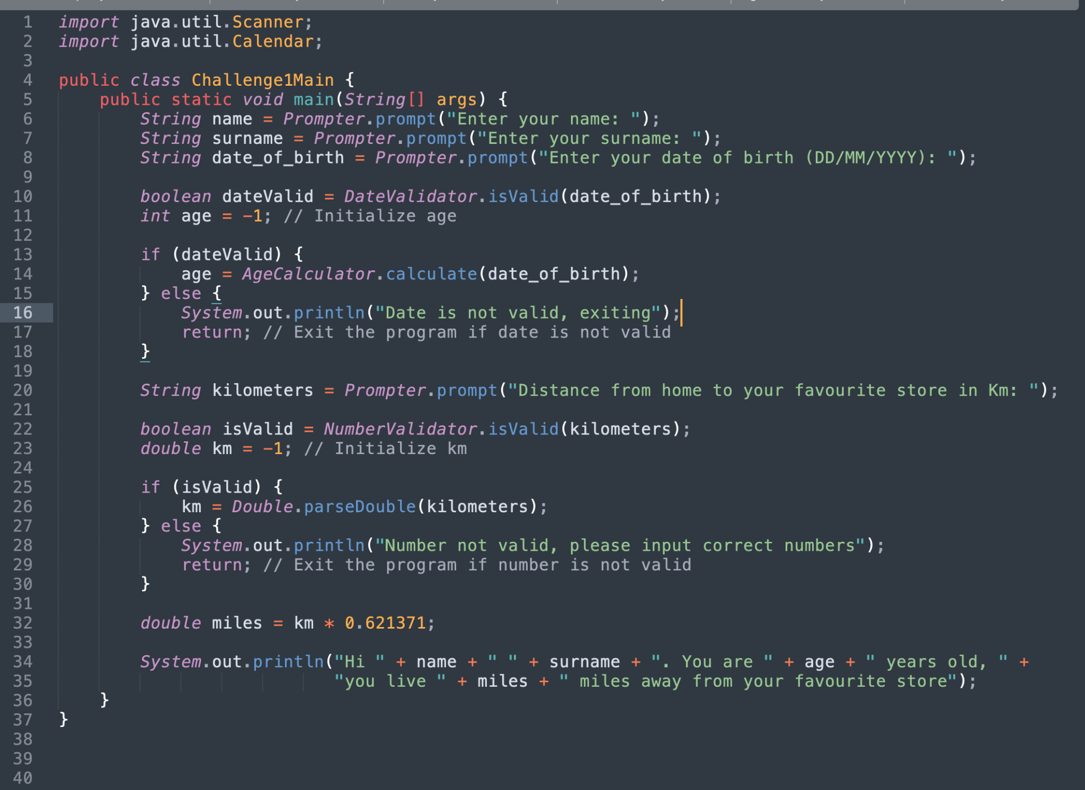
Solution
Developed a program using four classes: Prompter, AgeCalculator, DateValidator, MilesCalculator, NumberValidator, Main1Challenge and Printer.
Used the Scanner class for user input and Calendar for date calculations.
Implemented validation checks for both date and numeric input.
Calculated the age and converted kilometers to miles for final output.

Slide 5
Other Options
I could have used:
LocalDate from the java.time package for more modern date handling and validation.
JOptionPane for GUI
JOptionPane for graphical user interface instead of command line input.

Slide 6

Decisions
Used Scanner for simplicity and flexibility in handling user input.
Used Calendar class date calculations due to its comprehensive functionality

Slide 7

Summary
.Successfully created an interactive program to that collects user information and performs calculations.
Gained experience in Java input/output, date handling and exception handling.
Cemented my knowledge of Java fundamentals.

Slide 8
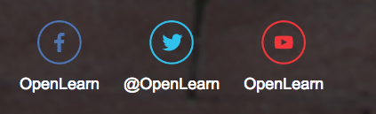
Follow us on these platforms for more :

